Slide 1
April1st@OECD
A mini campaign

Slide 2
WHY?
Prove OECD can be funny and light-hearted, yet serious about issues that count
Show 🔥!
Appeal to the general Internet public (remember the 15/25 age group? Millennials!)
Link OECD to an event that many can relate to (in the Western hemisphere at least)
Showcase lesser known as well as well-known areas of OECD work
Start a tradition?
Keep it light, in terms of effort!

Slide 3
Others do it
Google (on several properties, every year)
NPR, universities, Kickstarter, MoMA, MIT, Tumblr, Twitter, The Guardian, HuffPost, National Trust UK, CERN, Virgin, all sorts of websites
Media create lists of best April fools’ jokes around the world, e.g.:
https://www.theguardian.com/theguardian/2017/apr/01/fake-news-the-best-and-worst-april-fools-day-stories
https://www.theguardian.com/media/2014/apr/01/april-fools-jokes-2014-best-web

Slide 4

WHAT? - VEHICLES
Six fake publication covers with an intriguing blurb; here’s an example
After more than ten years of Blockchain and Bitcoin, it has become clear that only a tiny minority of Bitcoin users have been able to make a fortune.
To provide a level playing field for all and fight inequality, OECD researchers have bundled their extensive research in digital currencies and pyramid schemes and transformed it into a list of easy-to-follow steps that will allow anyone to finally profit from this solution in search of a problem.
Get your copy here.

Slide 5


Two more examples
With the legalisation of drugs like Cannabis making inroads all over the world, it becomes more and more difficult for the recreational user to know which place has the best Mexican Sativa, or where to find that Premium Skunk.
In a first attempt to provide evidence-based answers, OECD undertook a painstaking research effort to create an inventory of all Canadian dispensaries, listing for each the strains offered, average prices, whether on-site consumption is possible, what payment options are available etc.
An ad-hoc research group of volunteer analysts at OECD is now looking (anxiously) for the next country to legalise Cannabis. Chemical Testing Guidelines #401 for Canada is available now.
With the Marie Kondo-induced tidying craze in full swing, people all over the world folding clothes and cleaning out their garages, one category has been glaringly absent: How do you store your offspring in an efficient manner, with easy access and minimum use of that scarce storage space?
OECD researchers have looked at this question, with their well-known eye for detail and have published the Working Paper “Babies in Boxes” that provides several evidence-based solutions for optimal storage. Find out more.

Slide 6
Let’s have a competition!
Make your own fake cover
https://jfix.github.io/cover-image-position/

Slide 7
WHERE? - VECTORS
OECD.org - carousel on home page, but landscape format; better focus box?
oecd-ilibrary.org - carousel on home page
Facebook - OECD account
Twitter - one or two tweets on OECD account
Newsletter - two publications in a dedicated newsletter
LinkedIn
Press release? Instagram? (no links!)

Slide 8
target
A simple web page that works well on mobile
https://jfix.github.io/040119/ (could be custom domain, but “KISS”)
Make it clear people have been fooled
Rickroll video https://www.wikiwand.com/en/Rickrolling
List of all covers with some serious commentary and a link to the “real deal”
Some disclaimer making it double-clear it’s all a joke

Slide 9
WHEN? - TIMING
 | If scheduled (automatic) |  | If manual launch
 | Start | End | Start | End
OECD.org | 31 March 22:00 UTC (midnight Paris) | 2 April 07:00 CEST (midnight PDT) | 1 April 09:00 CEST | 2 April 09:00 CEST
iLibrary | 31 March 22:00 UTC (midnight Paris) | 2 April 07:00 CEST (midnight PDT) | 1 April 09:00 CEST | 2 April 09:00 CEST
FB | 1 April 10:00 CEST (Europe) 1 April 16:00 CEST (US) | n/a | n/a (https://www.facebook.com/help/389849807718635)
Twitter | 1 April 10:00 CEST (Europe) 1 April 16:00 CEST (US) | n/a | n/a (e.g. https://blog.hootsuite.com/how-to-schedule-tweets/)
Newsletter | 1 April 06:00 UTC (to arrive in EU and US after) | n/a | n/a (see Adrestra doc for scheduling)
LinkedIn | 1 April 14:00 CEST (Europe) | n/a | n/a (e.g. https://www.linkedin.com/pulse/how-schedule-posts-linkedin-free-max-bradley/)
Press release | 1 April 10:00 CEST | n/a | 1 April 10:00 CEST | n/a

Slide 10
HOW? - User Journeys
All vectors have one, sometimes two covers, some intriguing text for each, and a link (the cover itself should also be clickable)
People click (hopefully) and
In most cases, people will end up directly on the April Fools page
In the case of the Fruits and Vegetable Interactive Edition, people will first go to a themed memory game (using photos from Fruits and Vegetable publications); once solved, or when abandoned people will end up on the April Fools page
Mobile use fully supported

Slide 11
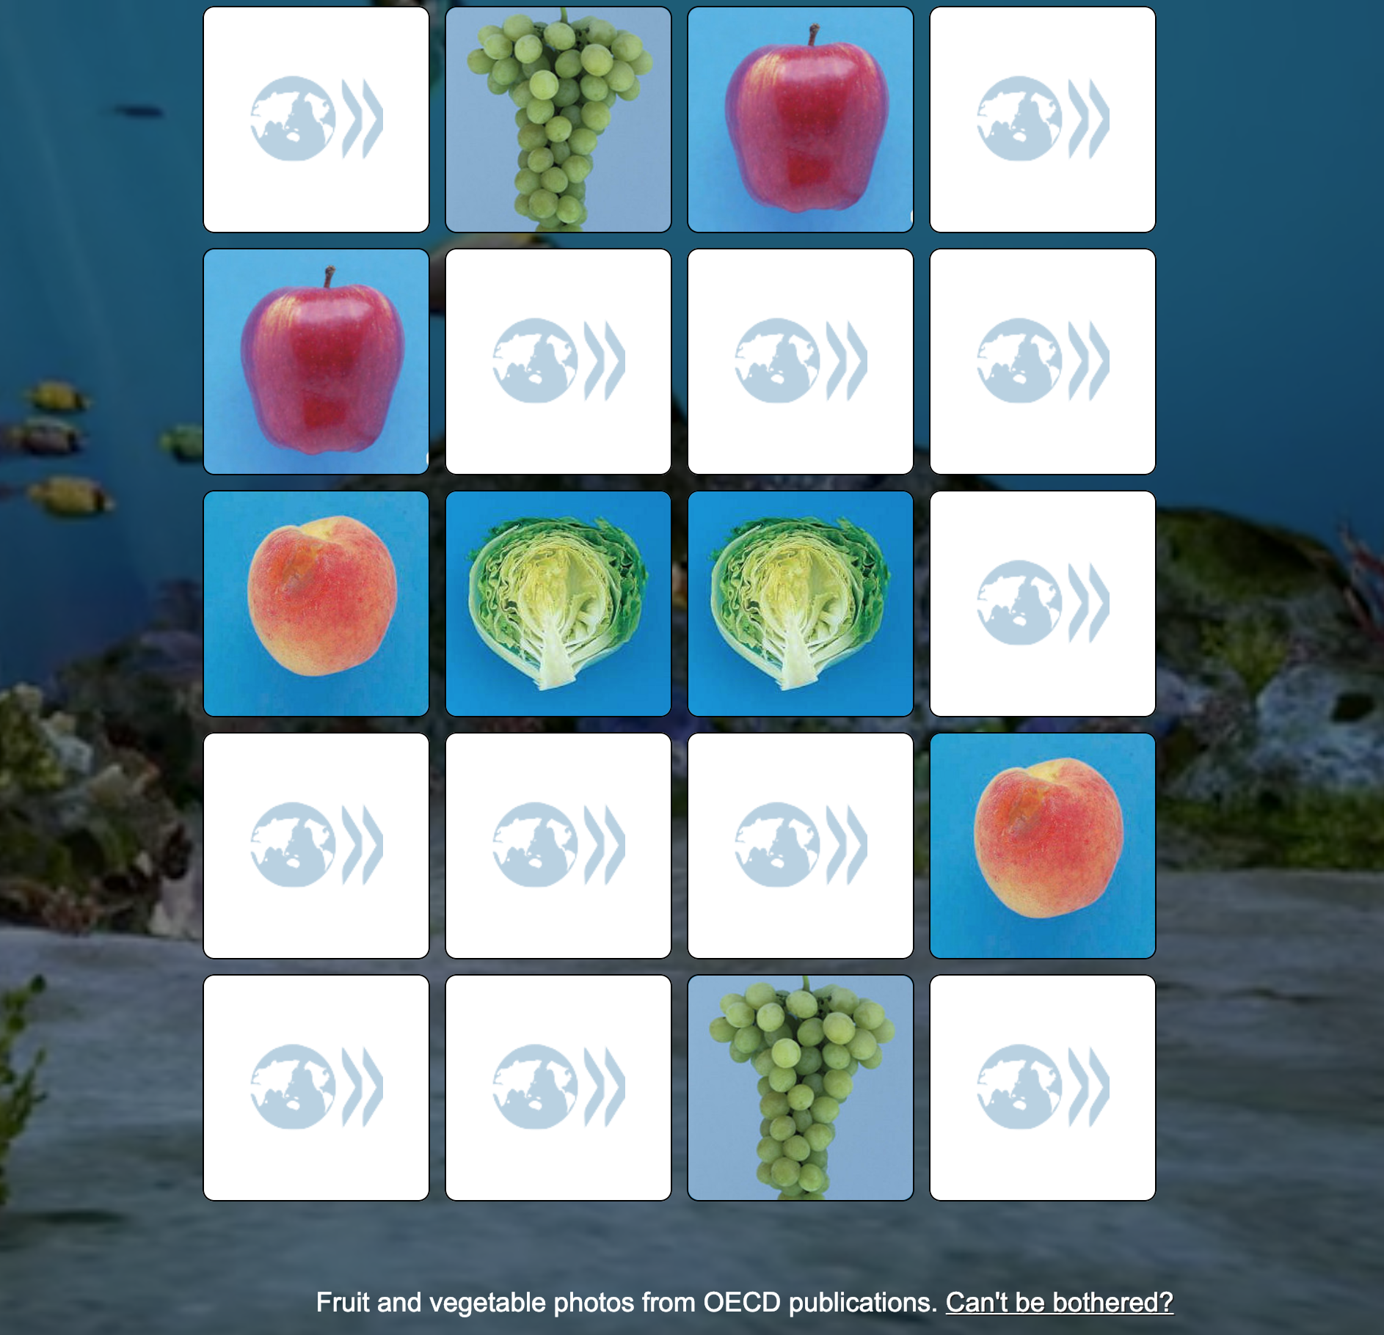
Interstitial - memory game
Only for Fruit and Vegetables edition
Optional, user can bail out
Also linked to from target page

Slide 12
Success and how to measure it
Retweets, Likes, Shares, Google Analytics, any other channels (email, calls?)
Potentially an uptick for the six DOIs on that day (via UsageStat)
On the page itself: just basic GA using the usual parameters
utm_source: one of twitter, facebook, oecdorg, ilibrary, newsletter, pressrelease
utm_medium: one of cover, link, button
utm_campaign: 010419

Slide 13
Limitations
English only (minimal effort)
Ephemeral page (no archiving)
No integration with OECD.org/T4

